Slide 1
Flash Flood Early Warning System(FFEWS)
Supervisor: Dr. Sanjeeb Prasad Panday
Team Members:
Pramithas Dhakal (067BCT529)
Suraj Pandey (067BCT543)
Suraj Subedi (067BCT544)
Saurab Dulal (067BCT548)

Slide 2
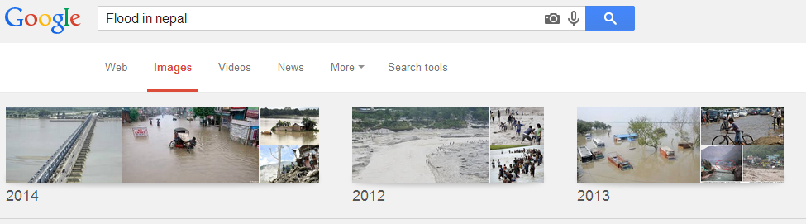
Background

Slide 3
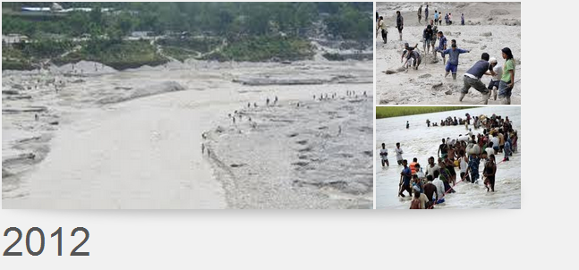

Slide 4
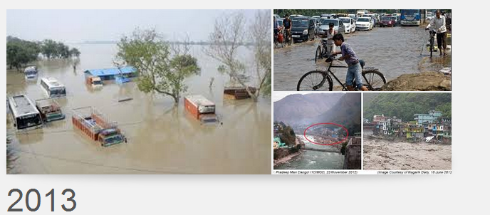

Slide 5
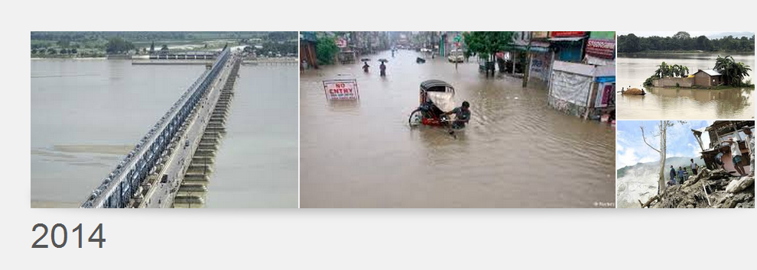
Background

Slide 6
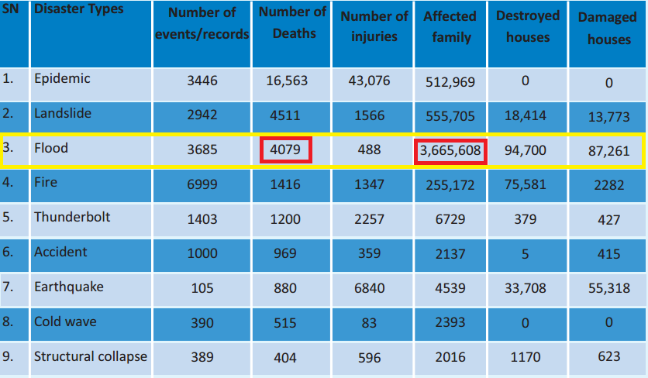
Background
Source - MoHA

Slide 7
Loss of Lives Due to Flood and Landslide in Nepal

Slide 8
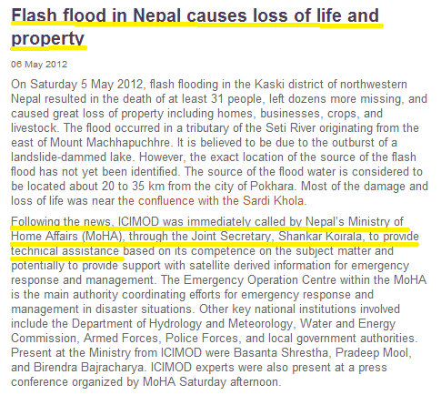
Problem!

Slide 9
Problem Statement
Lack of accurate and statistical data, no inference system and even unavailability of sensing device to these big rivers turns out to be one of the major problems,
Absence of EWS in risk exposed area.

Slide 10
Objective
To build an early warning system and data analysis tool.

Slide 11
Flash Flood Early Warning System (FFEWS)

Slide 12
Early Warning System(Operational Framework)
Early Warning Systems: A Tool for Mitigation and Coordination
Monitoring of precursors
to natural events.
Early Warning Systems (EWS) operate on a very simple operational framework.
Precursors to events are monitored on a continuous basis. Data is analyzed to generate a forecast.
If there is a forecast of a large event, a warning is issued.
Disaster Management Measures are adopted after the warning is issued.
NO
Forecasting: Will there be an event?
YES
Issue a Warning or an Alert.
Initiate actions according to emergency plans

Slide 13
What is FFEWS?
FFEWS
Flood Forecast
Data Analysis and Visualization
Warning
System
Real Time Flood Monitoring

Slide 14
Real Time Flood Monitoring
Real time data collected by DHM from monitoring Stations
Extraction of Data From DHM Site
Monitoring of data for critical level
Issue Warning if the data is above the critical value

Slide 15
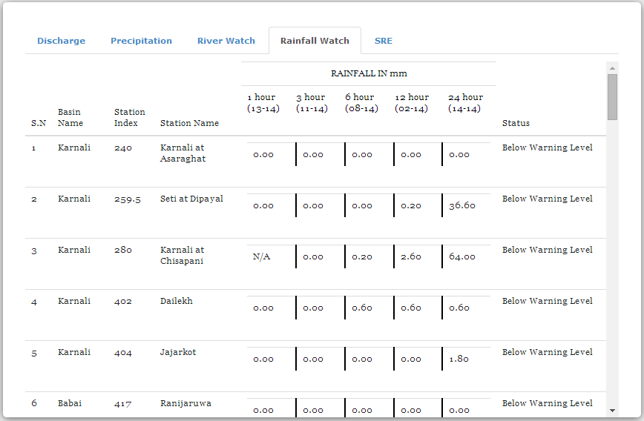
Real Time Rainfall Watch

Slide 16
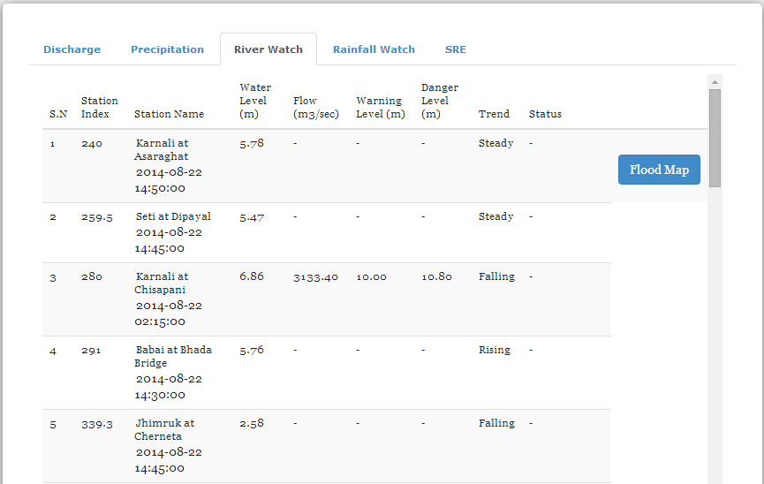
Real Time River Watch

Slide 17
Data Analysis And Visualization
Flood Frequency Analysis
An analytical technique that involves using observed annual peak flow data to calculate statistical information, such as mean values, standard deviations, skewness, and recurrence intervals.
Flood frequency analyses are used to predict design floods for sites along a river.

Slide 18
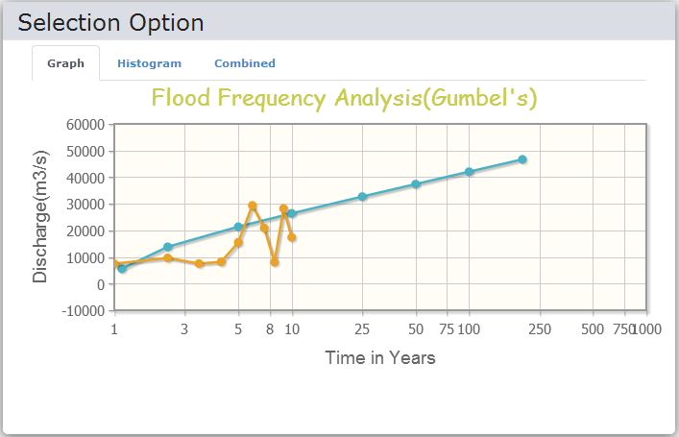
Flood Frequency Analysis (Gumbel’s Method)

Slide 19
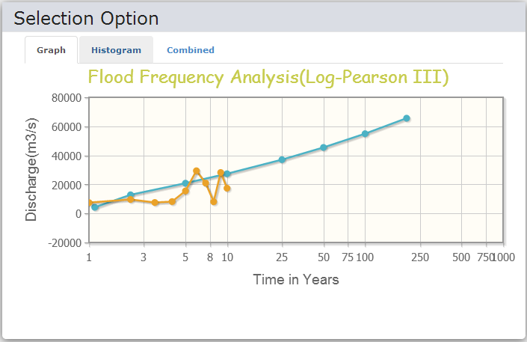
Flood Frequency Analysis (Log Pearson III)

Slide 20
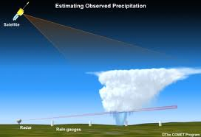
Flood Forecast
Based on the Satellite Rainfall Estimation (SRE)

Slide 21
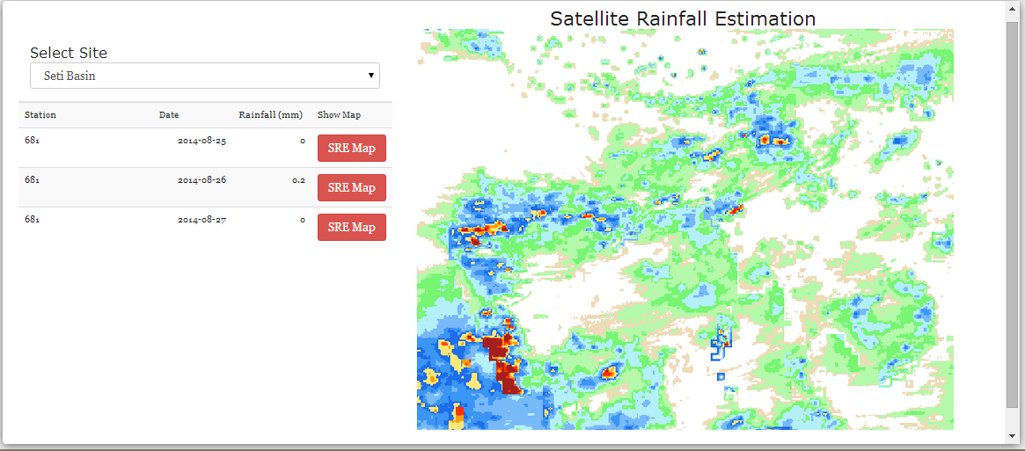
Satellite Rainfall Estimation

Slide 22
Flood Map Generation
When the discharge level reaches the critical level, warning is generated in the system
System user generates a flood map following the warning message.

Slide 23
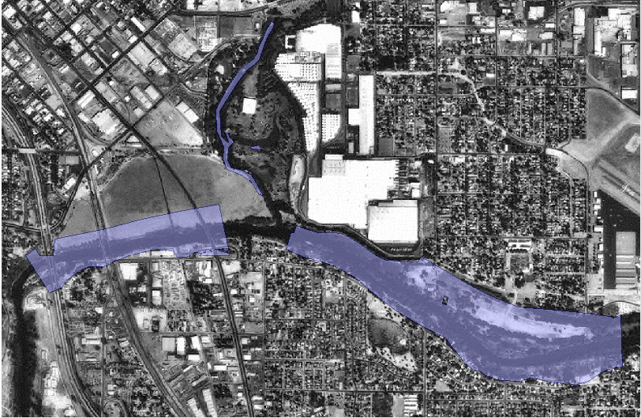
Flood Map Generation (Cont..)

Slide 24
Observation of Flood Map

Slide 25
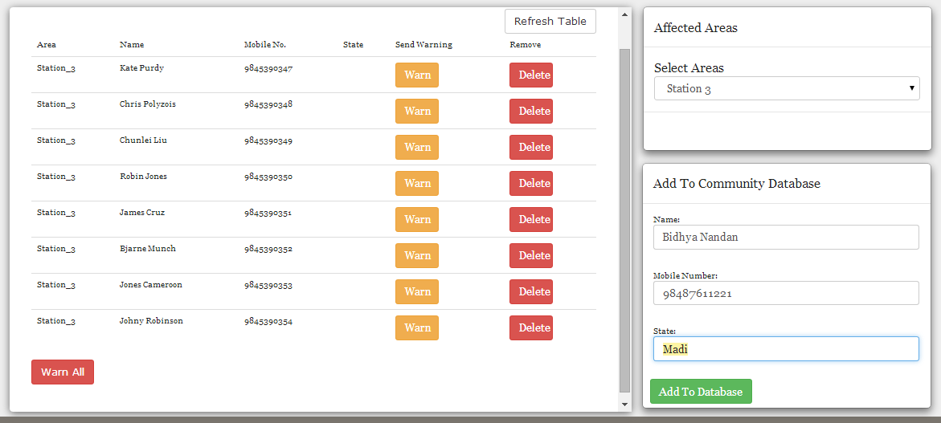
Warning System

Slide 26
Conclusion
FFEWS can forecast the occurrence of flash floods.
Warning can be issued to the authorities of vulnerable communities
Analysis tools in FFEWS are used to perform the frequency analysis on the available data
All these features of FFEWS can save the lives of hundreds of people and millions worth of properties.

Slide 27









Tools Used

Slide 28
Limitations and Enhancements
Limitations
Lack of availability of Hydrological and Geographical Data for the Same site
Lack of precision and accuracy due to low resolution data
Not tested and validated for real data
Future Enhancements
Enhancing accuracy with high resolution data usage
Automation of flood map generation and warning system
Development of the System as a DSS for the institutions working in this field

Slide 29
Thank You!

